Slide 1
DS7330 Project
Patricia Attah Fall 2020

Slide 2
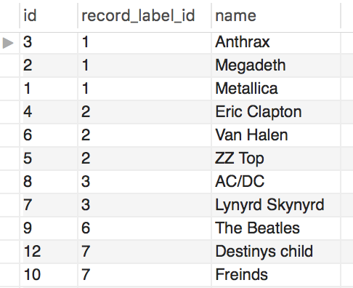
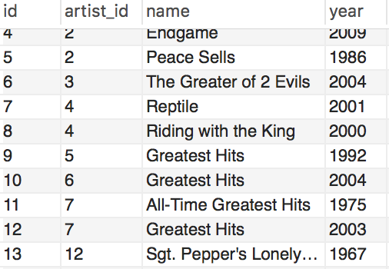
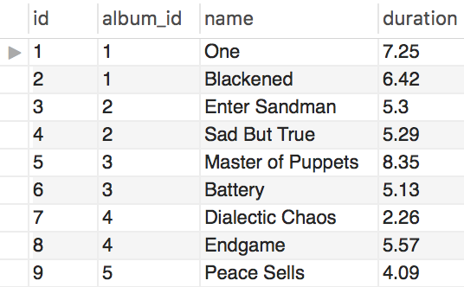
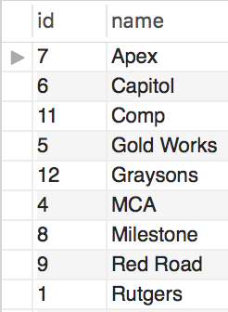
Tables:
Artist
Album
Record label
Song

Slide 3
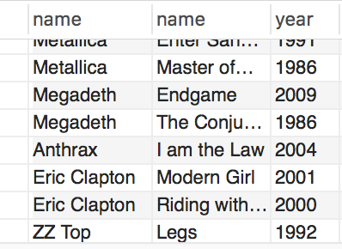
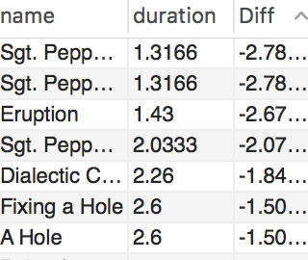
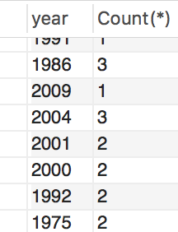
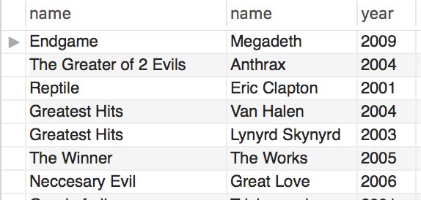
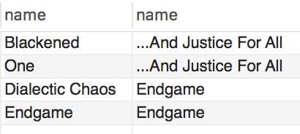
COMPLEX QUERIES
correlated inner query : the name of songs in each album that that were longer than the average duration for that album.
inline query: The difference between the average song and other songs.
aggregate function: The number of albums produced by year
join operations: All albums produced over the year 2000
set operation: the song name and album name of music that was produced in year 1988 and 2009

Slide 4
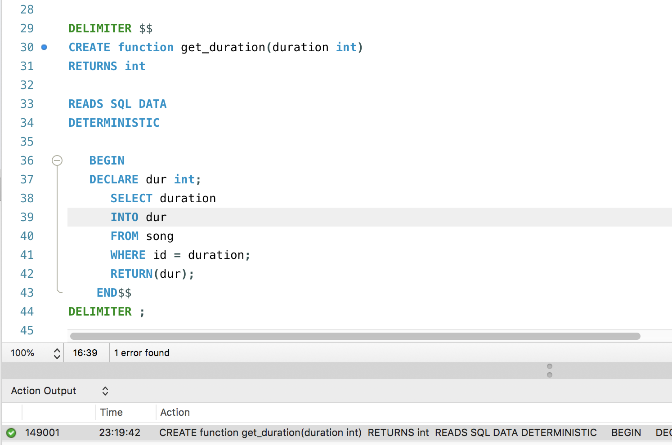

STORED FUNCTION
Function returns the duration of a song using the id of the song
SELECT get_duration(2)

Slide 5
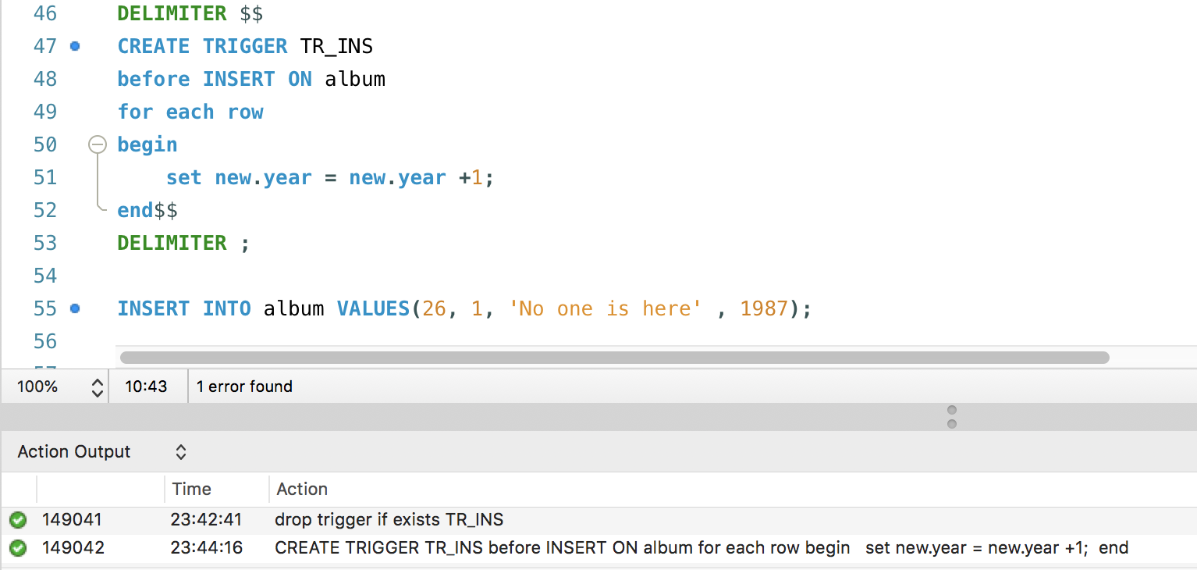

TRIGGER
Adds an additional year to the year that is entered to the insert statement

